Slide 1

Website Development: Lesson 2
Facilitated by: Titus Kariuki
Notes:
Web development kahoot

Slide 2
Getting ready for class
A laptop
Log into Codepen
Fill out this form: www.tinyurl.com/23e3hksw
Attention!!!
Have the following: 👉🏽

Slide 3
Agenda
Sartu’s Introduction
Ice breaker
Recap
Text Tags
Lists
You’re Learning List
Adding Images
Picture Perfect
Q&A
Closing

Slide 4



Confused
First coding course in 8th grade
Wanted to be in the healthcare field
Had no clear direction or interests

Slide 5
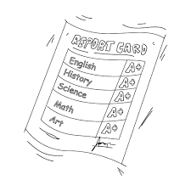



Focused On Healthcare
Only took classes that would lead me to the healthcare field (biology, chemistry, physiology)
Got good grades but didn’t challenge myself
Ignored interests I had in other subjects
Decided to do running start

Slide 6

Extracurriculars
Y-scholars
Seattle Youth Traffic Court
National Honor Society
African Student Union
Team Read
Carolyn Downs Family medical center (Odessa)
Race and Equity Team
Working

Slide 7

Applying for College
UW fit all of the requirements for my study interests
Close to home, affordable, prestigious programs
Only applied to UW….
Didn’t apply for many scholarships….
Got support at UW admissions office and essay writing night

Slide 8

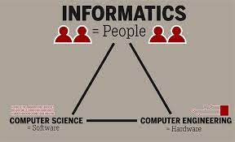

At UW
Interests changed to Nursing within 2 months at UW (work at the School of Nursing)
In my 3rd year, decided to change my major to Informatics (still have interest in healthcare)
Learning to be independent and good study habits post Covid-19
Through AVELA and my classes, discovered my interests

Slide 9

Ice Breaker!
Favorite food
Favorite local restaurant

Slide 10

Recap
What is engineering?
What is web development?
What is HTML?
What are HTML tags?

Slide 11
Recap
Engineering = Building stuff.
Web Development = Creating and “babysitting” a website
Babysitting a website = taking care of (maintaining) a website.
Web Development = Engineering + Websites

Slide 12
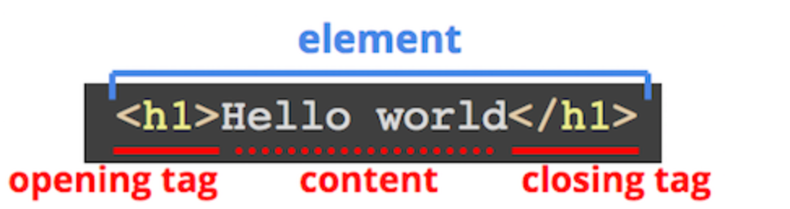
Recap
HTML: HyperText Markup Language
Most-used language for creating web pages
HTML Tags:
A HTML tag shows the start and end of a code.
Tags help web browsers convert HTML stuff into web pages.

Slide 13
Recap

Slide 14
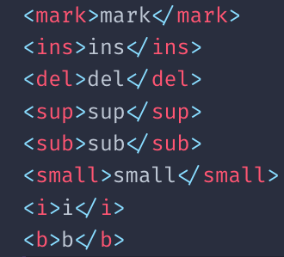

Text Tags
What are HTML text tags?
Text tags change how a text looks.
Why use them?
To changing some stuff in the code but not all of it. (Like, some words.)

Slide 15
Practice
Start the document with an opening and closing html tag:
<html>...opening
</html>...closing
In between the html tags, add opening and closing body tags
<body>...opening
</body>...closing

Slide 16
Practice
In between the body tags, do the following:
Write your name using a heading tag:
<h>...opening
</h>...closing
Write about the day you learned HTML using paragraph tags.
<p>...opening
</p> closing

Slide 17
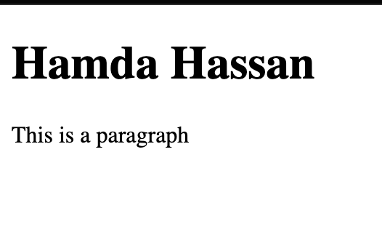
Practice
It should look something like this:

Slide 18
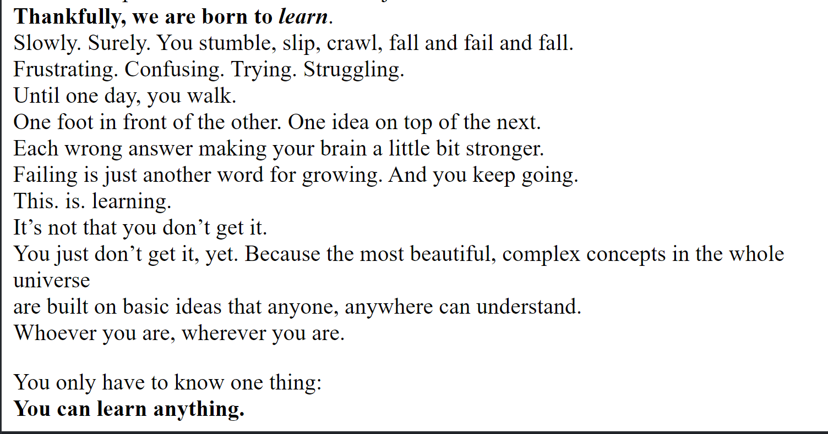
Challenge 2: HTML Text Tags
Edit your paragraph with some *pizzazz*

Slide 19
Challenge 2: HTML Text Tags
HTML text tags to use
What it does | Opening Tag | Closing Tag
Highlighter | <mark> | </mark>
Underline | <ins> | </ins>
Superscript/exponent | <sup> | </sup>
Subscript | <sub> | </sub>
Small | <small> | </small>
Italics | <i> | </i>
Bold | <b> | </b>

Slide 20
Resources!!
www.htmlcheatsheet.com
www.my-learning.w3schools.com/tutorial/html

Slide 21
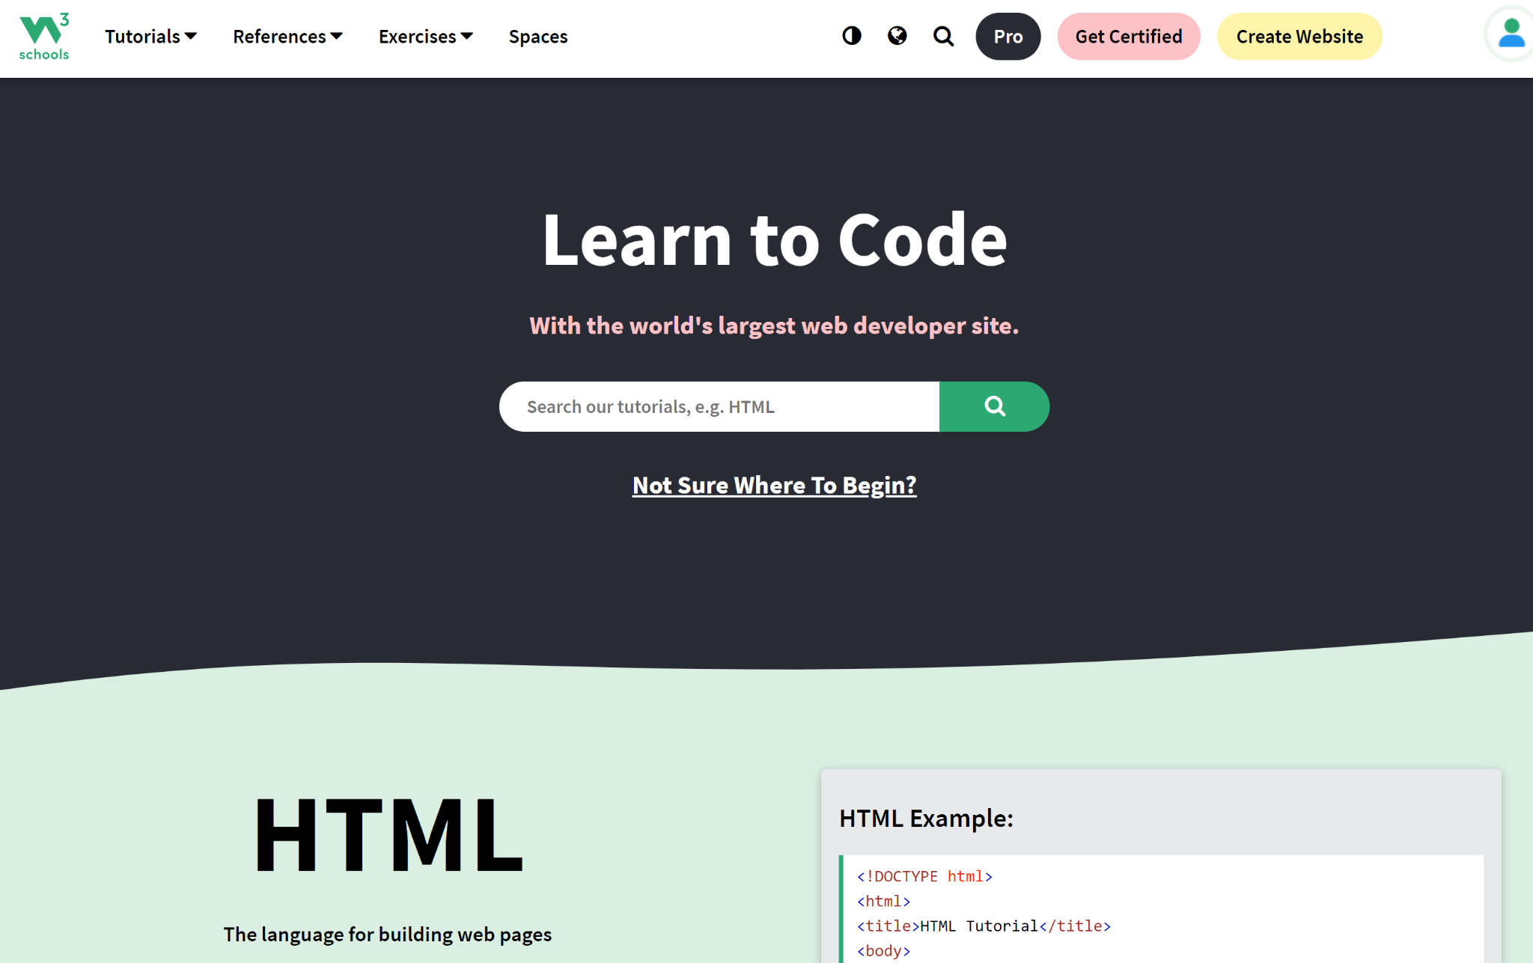
A Bit About W3Schools…
W3Schools
A website that teaches you how to code.
Many coding languages:
HTML
CSS
Java
Python
JavaScript
C++
C and more
FREE!!!
Use it to get ahead if you want. :)

Slide 22
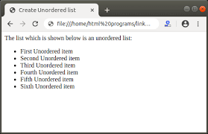
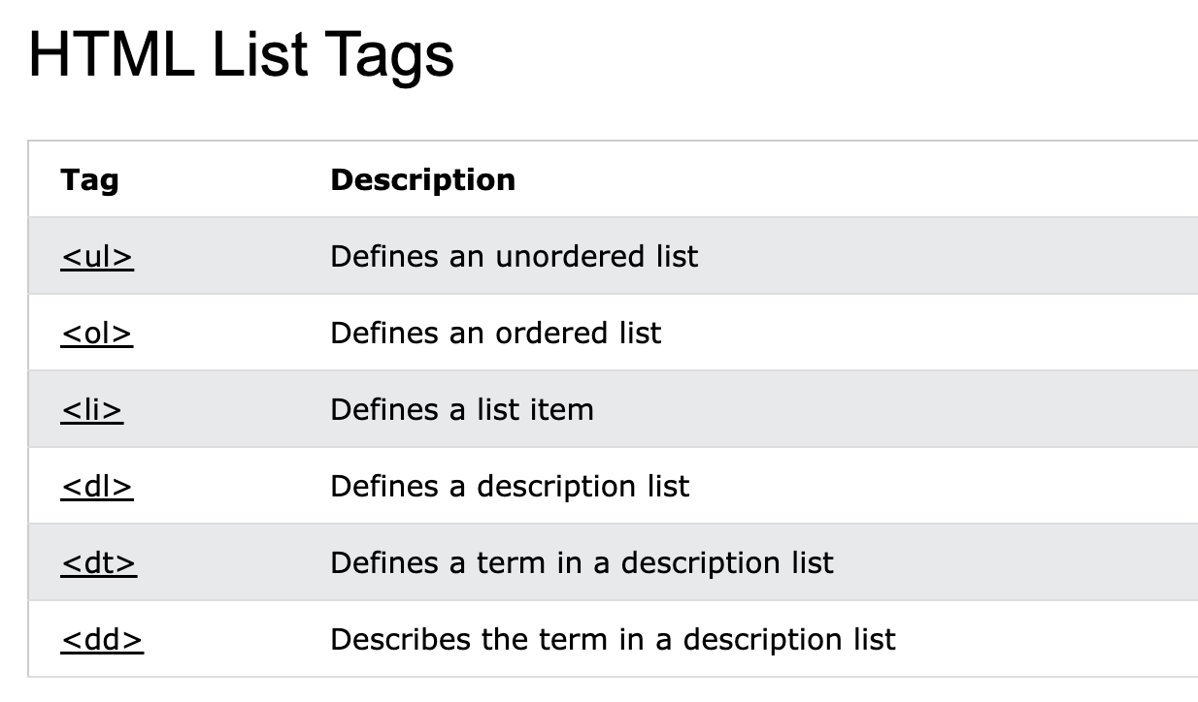
Lists
We use HTML lists to make lists…literally.
There are two types of lists: ordered lists and unordered lists.

Slide 23
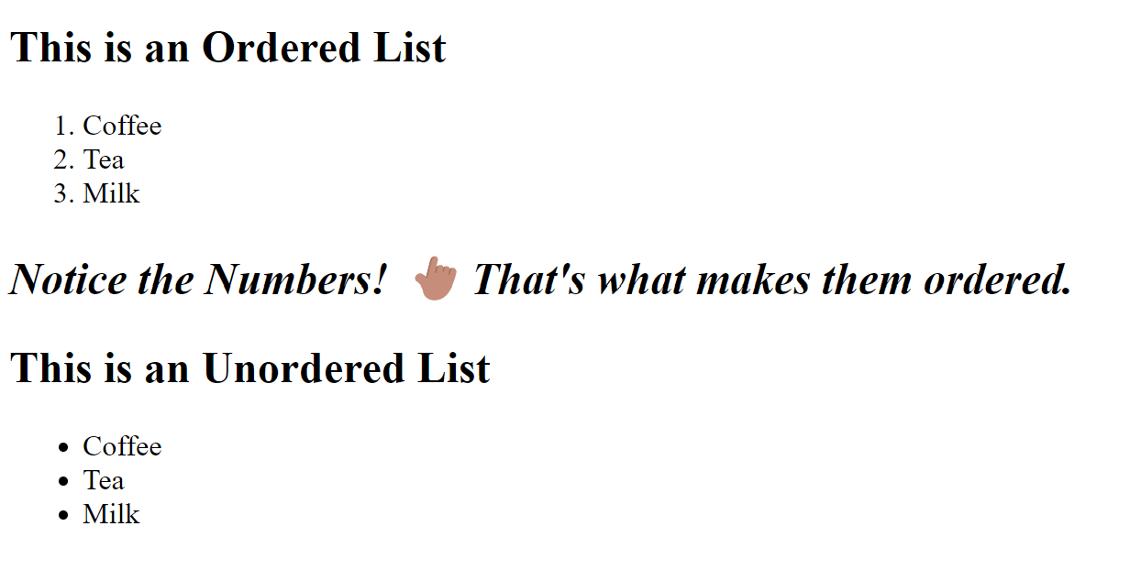
Lists

Slide 24
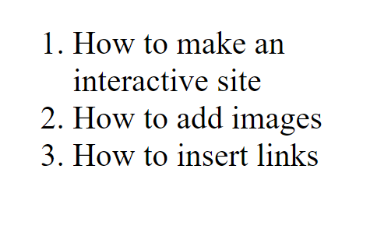
Challenge 3: Your Learning List
Try making a list of the things you do in your After-School Program.
It can look like this:

Slide 25
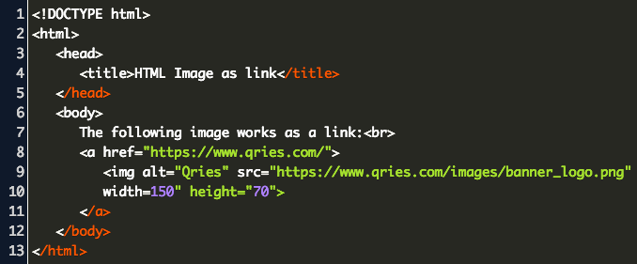
Adding Images
You can also add images to your code!
Use <img> tags to add images
You don’t own the images though, they are linked*
You only need an opening tag, no closing.
Only 2 things:
“Src” is the Source. It shows where you got the image from.
“Alt” is Alternative Text. It’s for people who can’t see an image.

Slide 26

Adding Images
If your image looks boring… you’re doing it right!
(image enhancing with CSS will be covered later)

Slide 27
Adding Images
Example
Lets add an image!
Open the image tag = <img
Describe the source of the image: src = “a link where you got your image from.”
Describe the alt text: alt = “Describe your image here.”
Add any width and height of your image: width = “ 0-1000” height = “0-750”
Close the element: >

Slide 28

Challenge 4: Picture Perfect
Something like this…
Final product: <img src="img_avelaLogo.jfif" alt="Avela Logo">

Slide 29

Today’s Recap
Congratulations!! You made it through Day 2 of Web Development!!
Here’s what you learned today:
Text Tags
Lists
W3Schools
Adding Images

Slide 30

Questions?

Slide 31

Closing Survey
Fill out this survey to help me teach you better. It’s secret:
https://tinyurl.com/32ay68rt

